Slide 1
Stem Cells
&
The Future of Medicine
Dr. Saqer Al Mualla
Deputy Chief Executive Officer &
Head of Plastic Surgery Department –
Al Qassimi Hospital
Sharjah-UAE

Slide 2
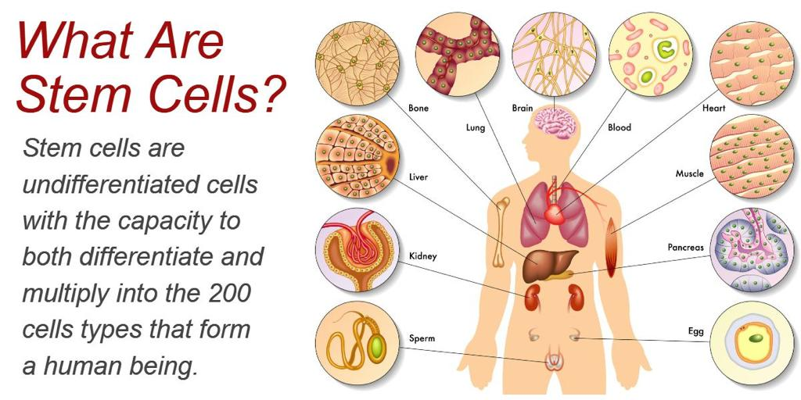

Slide 3
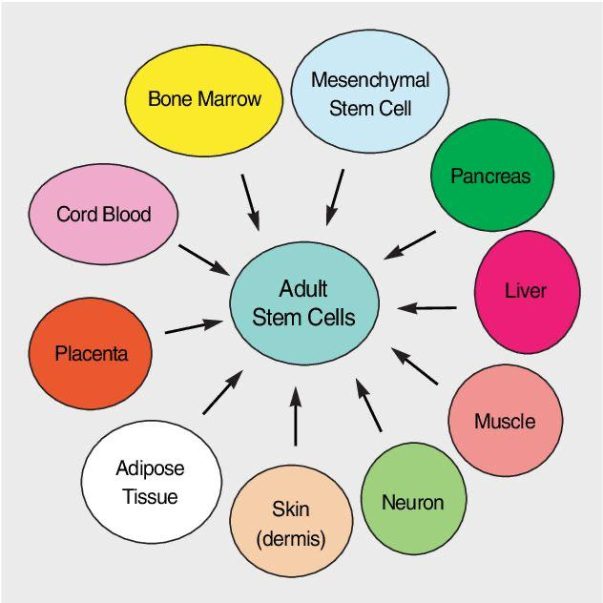

Slide 5
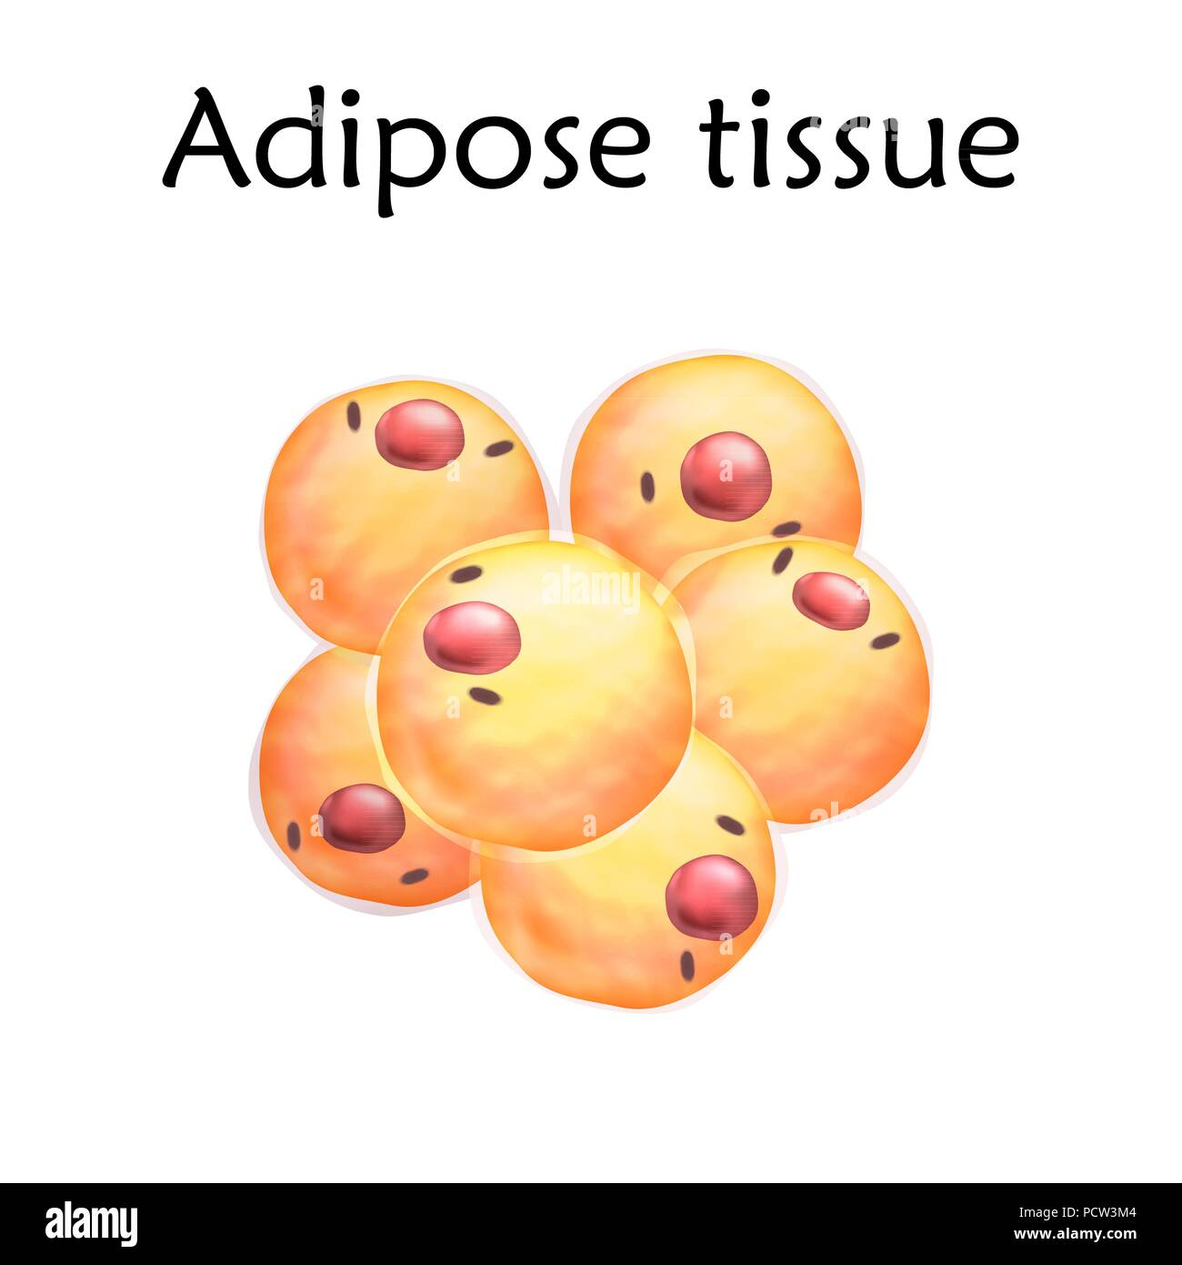
Adipose tissue on average has 100-500 times as many stem cells as Bone Marrow .
The target cell in fat tissue is called the Pericyte which exists on the small blood vessels in adipose tissue .

Slide 6
How to get Autologous adipose tissue ECM Patch :
LIPOSUCTION UNDER LOCAL ANESTHESIA
Procedure of Tumescent Liposuction
Clean operation site with antiseptic solution
Local anesthesia at incision site (e.g., using Lidocaine)
Inject Tumescent solution* (approx. 100~150ml) evenly into the subcutaneous of the abdomen
Incision only enough to insert a cannula (about 3~5mm)
Tunnel to break up fat (see Video 1)
Suction fat
(ex: Surgical suction machine, manual negative pressure suction device)
Suture the incision (e.g., suture, glue)
*Standard tumescent solution (can be modified):
500 mg lidocaine, 1 mg of epinephrine, and 10 mEq sodium bicarbonate added to a 1 L 0.9% NS

Slide 7
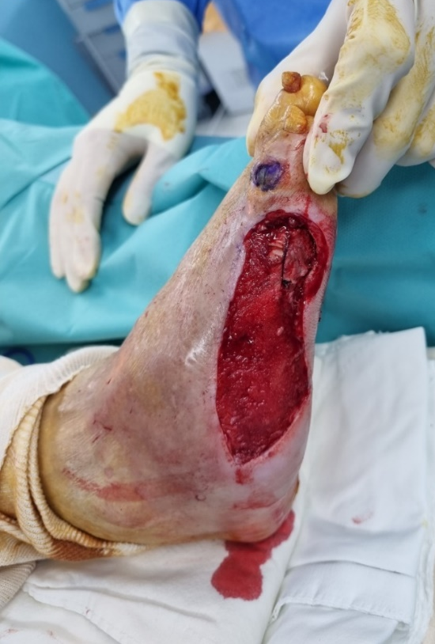
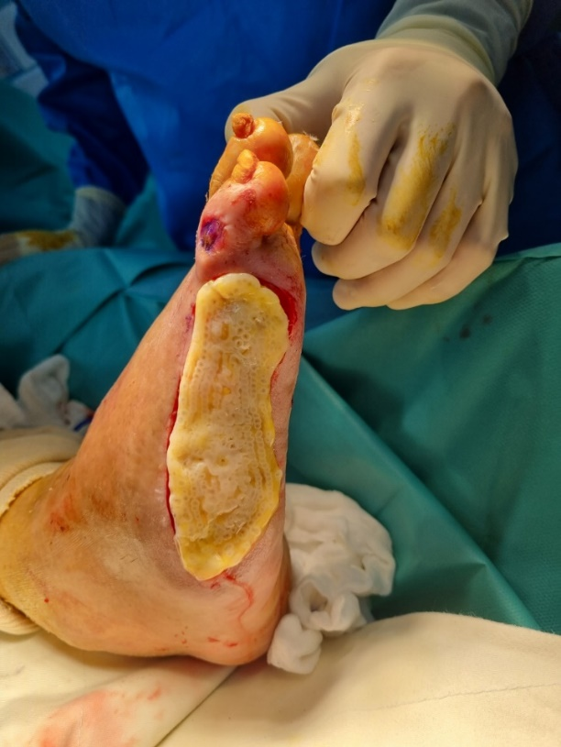
How to get Autologous adipose tissue ECM Patch :
USE 4D BIO-PRINTER ( Artificial Intelligence )

Slide 8
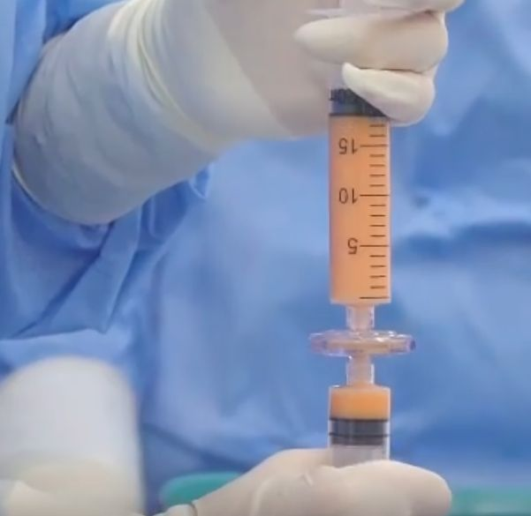

Slide 9
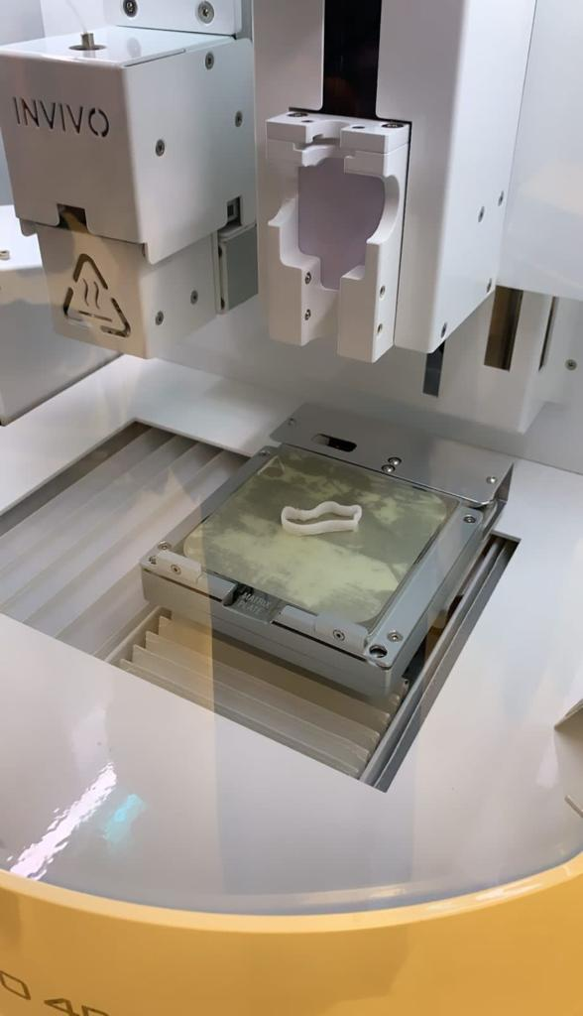
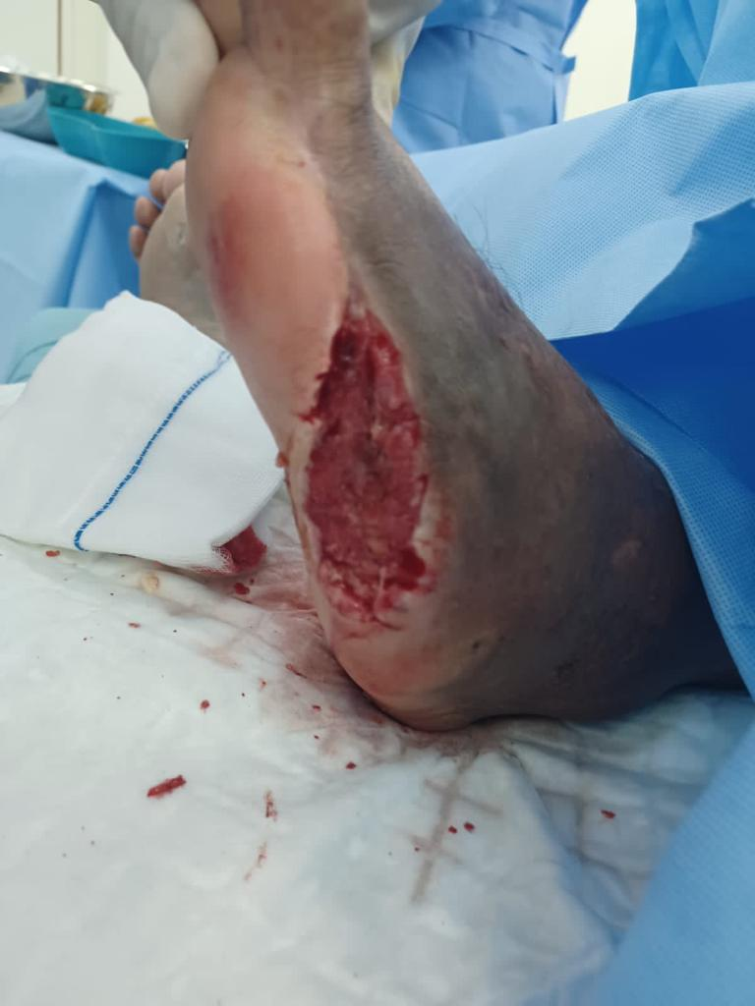

Slide 10
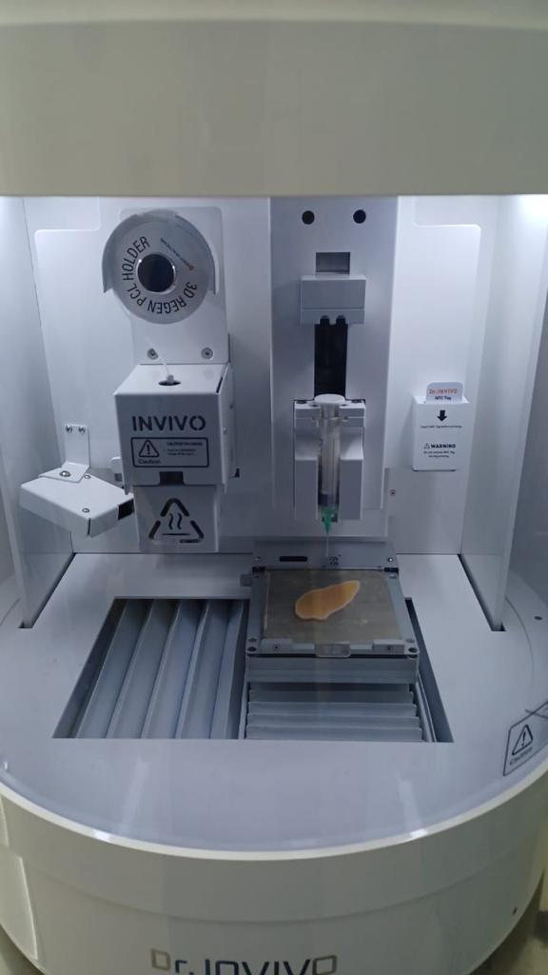
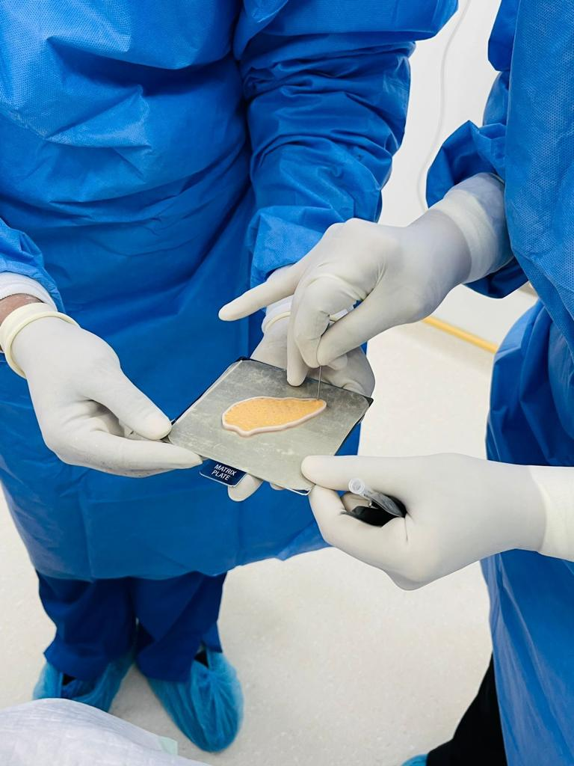
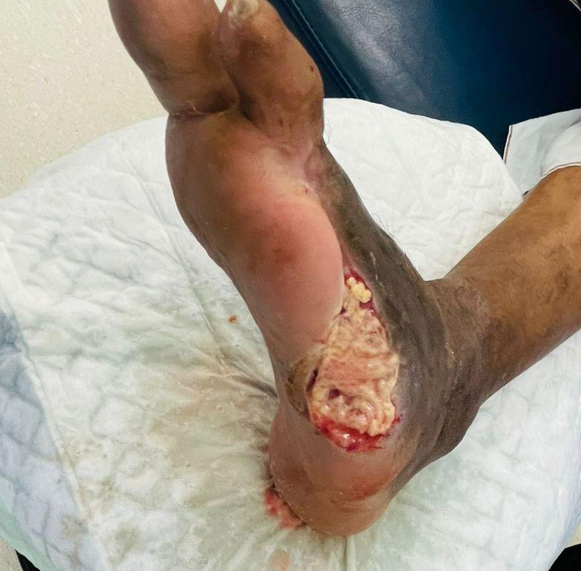

Slide 11
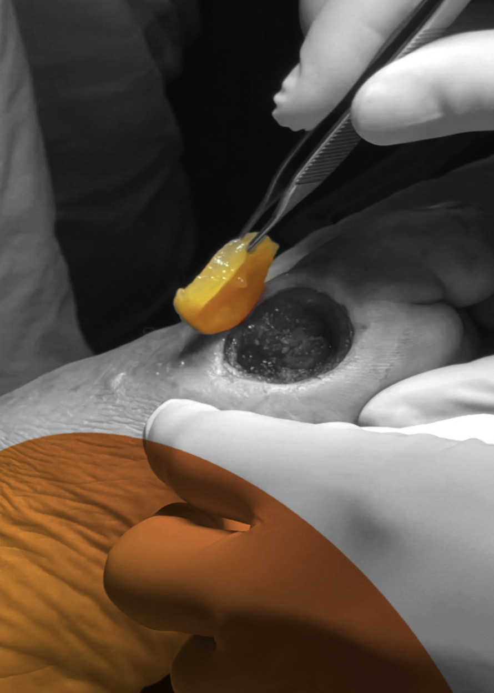
Autologous Adipose tissue with 4D Bioprinter :
Key Benefits :
Autologous Adipose Tissue – No immune Rejection .
Average 87% healing rate in ( in 4 to 6 weeks ) .
One-time treatment within 45 minutes with AI & 4D bioprinter .
No secondary wound or hospitalization .
Indications :
Diabetic Foot Ulcer
Burns
Pressure Ulcers
Bedsores
Skin cancer resection scars

